Slide 1
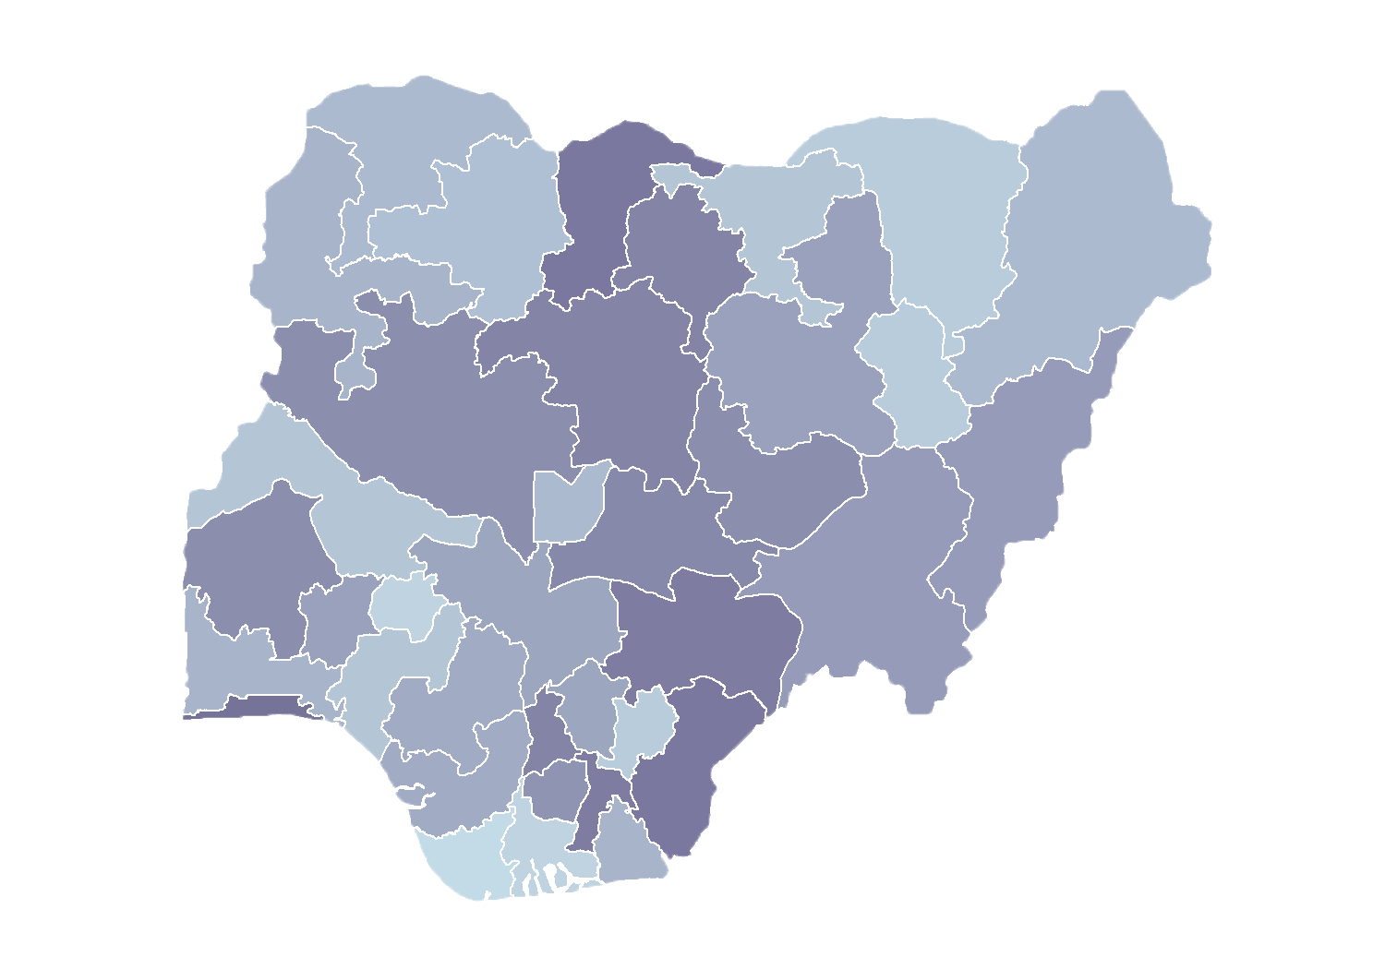
Module 1.1
Overview of Master Facility Lists in Nigeria
Rollout of Health Facility Registry/Master Facility List for States and Local Government Areas in Nigeria
March 2019

Slide 2
Outline
Introduction
Background
Elements of functional Master Facility Lists (MFLs)
Process of facility listing
Health Facility Registry (HFR) development
Governance
Plans for rollout

Slide 3
Introduction
What is the MFL?
What is the HFR?
Master Facility List
What is the difference?
Comprehensive list of health facilities
Unique identifiers
Verified (last 2 years)
Updated according to standard operating procedures (SOPs)
Accessible to key stakeholders
Health Facility Registry
Database that houses the MFL
Facilitates sharing interoperability
Communicates with other systems
Notes:
According to the WHO resource package published in early 2018, a functional MFL will have the following characteristics:
The MFL is comprehensive, including all health facilities in the country
The MFL has an established minimum data content that includes unique identifiers for each facility
The MFL data are current and have been verified within the past two years
The MFL is updated regularly and the updating process is supported by an established set of standard operating procedures
The MFL is visible and accessible to key stakeholders and data consumers

Slide 4
Introduction
What else is needed?
Governance structure
Governance structure that provides oversight and management of the MFL
To ensure the MFL and HFR meet the needs of stakeholders
Master Facility List
Comprehensive list of health facilities
Unique identifiers
Verified (last 2 years)
Updated according to SOPs
Accessible to key stakeholders
Health Facility Registry
Database that houses the MFL
Facilitates sharing interoperability
Communicates with other systems
Notes:
The MFL is comprehensive, including all health facilities in the country.
The MFL has an established minimum data content that includes unique identifiers for each facility.
The MFL data are current and have been verified within the past two years.
The MFL is updated regularly and the updating process is supported by an established set of standard operating procedures.
The MFL is visible and accessible to key stakeholders and data consumers.

Slide 5
Background
In 2013, the Government of Nigeria (GON) published a list of health facilities.
Few parameters were collected.
Processes for continuous updating were missing.
In 2016/2017, a new initiative with USAID support:
MFL Technical Working Group (TWG) was established
Specifications for online facility registry gathered
Multiple lists were again compiled and validated
In 2018, further USAID support:
Development of SOP for HFR management
Configuration of online database strengthened
Integration of National Health Management Information System (NHMIS) with HFR
MFL was aligned with District Health Information Software (DHIS 2) facility list
Plans made to rollout facility registry to states

Slide 6
Consolidation of MFL
1. Stakeholders workshop
2. Harmonization of identified lists
Called by Department of Health Planning, Research & Statistics (DHPRS) Aug. 2016
Stakeholders presented their HFR lists
MFL TWG was formed
3. State-level draft MFL validation
Protocol to merge the list developed
10 different lists were used
2013 MFL used as base list
Draft MFL was produced
4. Additional list
DHPRS sent draft MFL to states for validation
Merged list of about 50,000 records was adopted
Additional HF lists were identified and retrieved
8 more lists were used
Global positioning system (GPS) data were collected
5. Data cleaning
Data collectors were used
Duplicates were cleaned
Data collectors visited states for validation
MFL with 39,550 records
Notes:
The following are some of benefits of the HFR.

Slide 7
Elements of functional MFL
Facility listing
The list that describes all health facilities in a country
Data covering predetermined facility attributes
Facility registry service
A platform for storing, managing, and sharing MFL
Enable data consumers to search, sort, and download MFL data
Facilitate interoperability with other data systems
Governance structure
Supportive policy environment
Leadership to oversee establishment and management of MFL
Integration of NHMIS with HFR
SOPs for maintenance of MFL
Resource allocation to support MFL

Slide 8
MFL/HFR development
Facility listing
Multiple facility
lists
MFL continuously updated and validated
Current, validated MFL that meets needs of data consumers
MFL with gaps and data quality issues
Functional, up-to-date, shareable MFL
Health facility registry
Text document
Spreadsheet with limited functions
Service that is interoperable with other systems
Web-accessible service allowing data consumers to view and interact with data
Governance structure
No policy or leadership around MFL
Stakeholder support for MFL
Strong leadership and oversight for continued MFL maintenance
Policies and standard operating procedures exist
Model adapted from https://www.who.int/healthinfo/country_monitoring_evaluation/mfl/en/
Notes:
This slide provides a model for how countries progress according to the three components (MFL, HFR, and governance structure) towards the overall goal of having a functional maintained, shareable MFL.

Slide 9
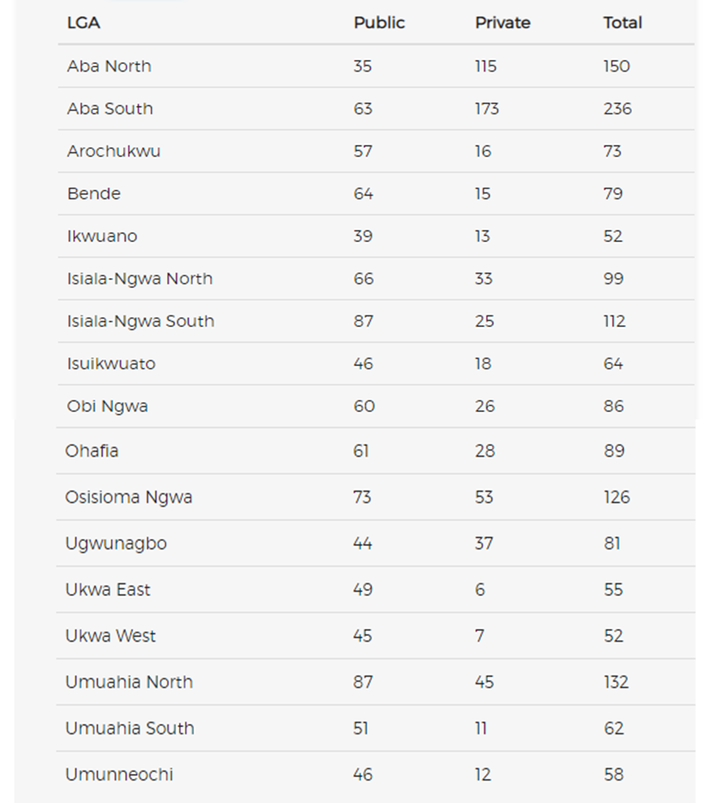
1,606 facilities in Abia
973 of these are public and 633 are private

Slide 10
HFR development
System to manage facility lists has been developed and hosted in the cloud
System is open to public; management of HFR has roles for the 3 tiers of governance in Nigeria
The system is built to support facility registration process workflow
HFR and DHIS 2 integration is ongoing; all updates in HFR will be sent to the DHIS 2

Slide 11
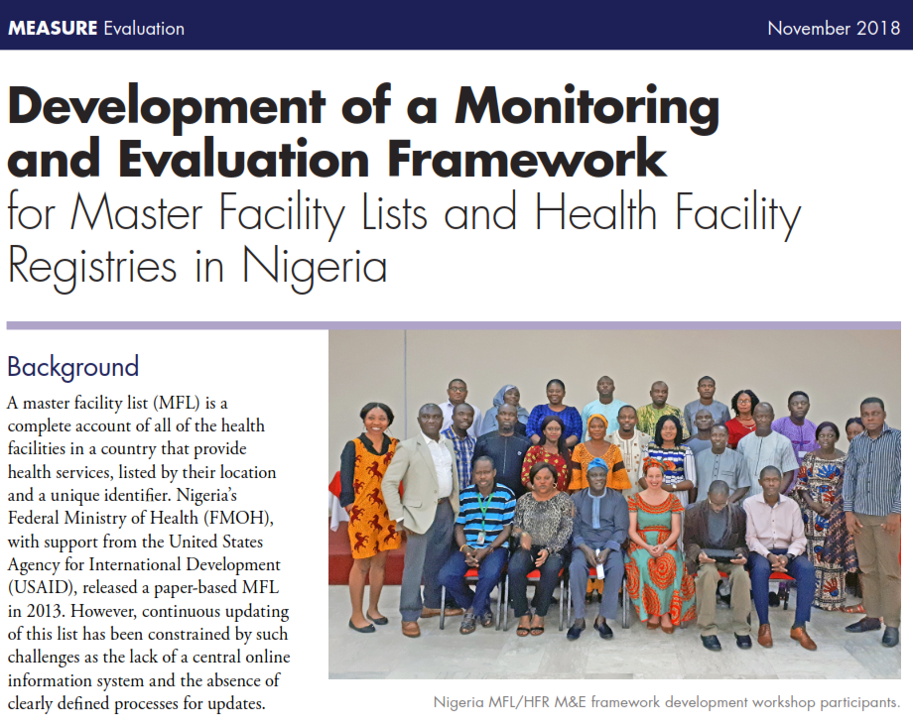
Governance (1)
For sustained systems
MFL Technical Working Group
Broad range of stakeholders
Motivated around common goal
Development of monitoring and evaluation (M&E) framework
Core group of Federal Ministry of Health (FMOH) DHPRS and ICT staff
https://www.measureevaluation.org/resources/publications/fs-18-317

Slide 12
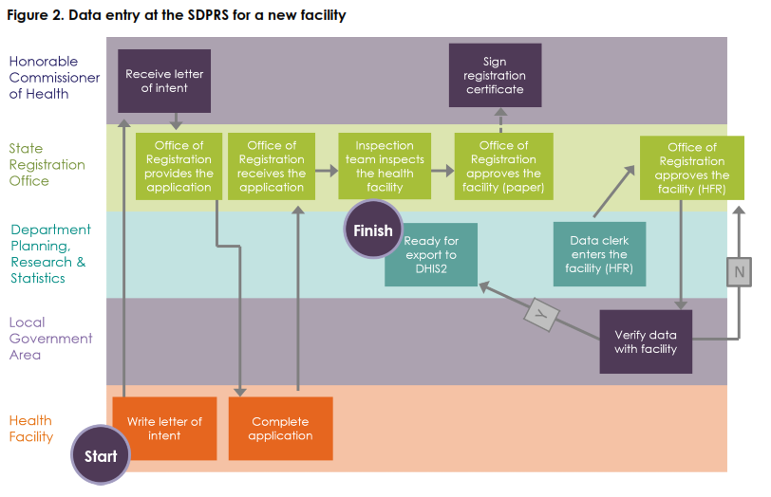
Governance (2)
Policy environment
SOPs
Representatives from 17 states
Described processes for facility creation, update, and closure
Produced standard workflows that can be adapted to state
Notes:
Supporting larger policy environment:
SOPs
Revisions to the implementation guide

Slide 13
HFR rollout in Abia and Niger
Jan – April 2019
Strategy will actively engage state and local government area (LGA) authorities and include three phases:
Session 1 training (3 days)
Train participants on the purpose of the MFL, data collection form, data quality, and use of GPS
Data collection
LGA authorities will visit health facilities as needed to improve data quality of MFL
Session 2 training (3 days)
Train participants on how to enter and validate health facilities in HFR

Slide 14
HFR rollout nationwide
May – September 2019
Leverage experience from Phase 1 in Abia and Niger
Improve on training materials
Improve on training methodology
Train more trainers for countrywide rollout
MFL TWG will continue to monitor MFL/HFR data quality for the states trained on how to use HFR, using the MFL/HFR M&E framework developed
MFL TWG will coordinate rollout efforts across the other states and Federal Capital Territory in the future (post-MEASURE Evaluation)

Slide 15
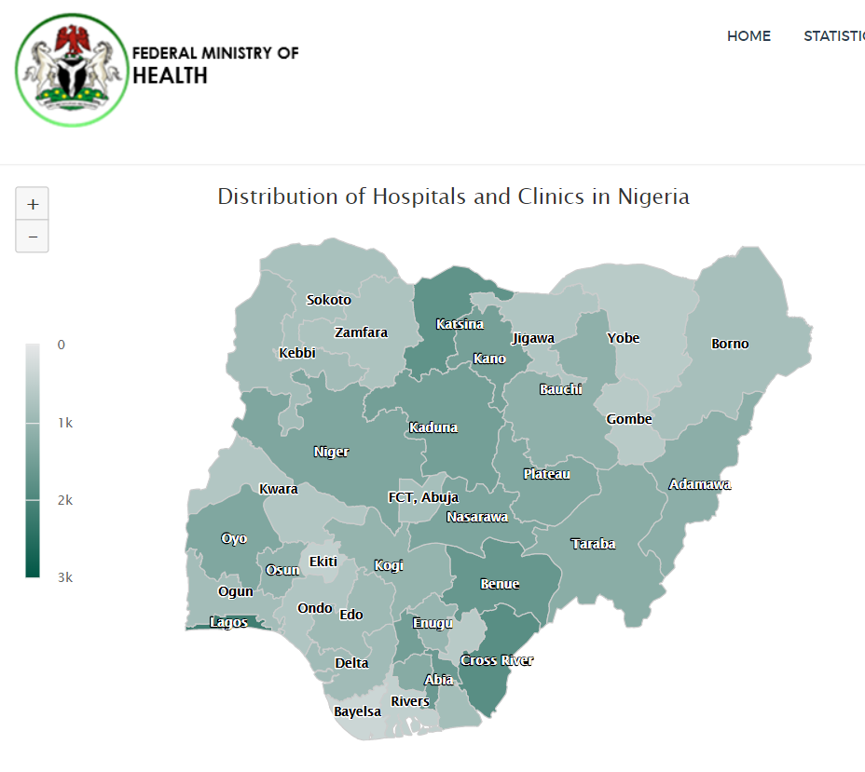
Thank you
To access the HFR, please visit https://hfr.health.gov.ng

